Slide 1
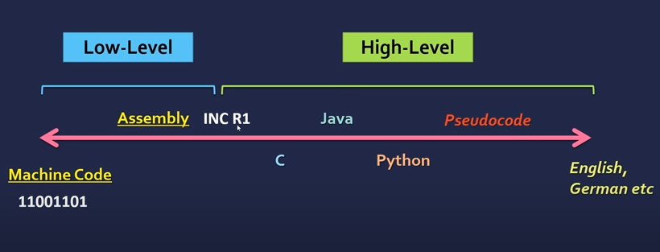
Programming languages
Formal languages designed to communicate instructions to a machine

Slide 2

Processors directly execute the machine code.
Machine code is specific to the processor type and is not portable. Each instruction will have its machine code which can be different for diff machines
Hence Assembly and high level code must be translated to machine code.
Assembly language use Mnemonics eg. INC, ADD, STR, BRANCH etc
ADD R2, 10 (Add 10 the value stored in Register R2)
Assembler will translate the above to machine code

Slide 3
High level languages
Easier to use. They are portable and you don't need to write hardware specific code like low level
Some high level languages will be more abstract than the others .
Less abstract languages will use constructs like pointers, enums, stacks, templates etc, eg C
More abstract languages leave more work to be done at runtime, so are slower to execute. Eg Python

Slide 4
Translators
Is a program that converts the code in HLL to equivalent machine code
Types of Translators:
Assemblers
Compilers

Slide 5
Assemblers
Assembly - > Machine Code
Produces an object file
Provide optimization by substituting the function calls (subprogram calls) with teh actual code inline, replacing macros and constants with their values etc

Slide 6
Compiler
High Level - > Machine Code
Compilers scan the whole code and generates a binary file (executable)
This executable can be kept and run independently without the need of the source code
Since it scans the complete code , it generates all the error messages at once
Can be awkward for debugging and also time consuming

Slide 7
Interpreter
Works line by line (translates a line and then immediately executes it)
So every time you want to execute the code, it must be translated again
Stops as soon as it reaches an erroneous line
Both the source code and the interpreter is needed at al the times
Slower than a compiler
(Languages work in a hybrid mode, there will be some compiled sub routines within a language being interpreted)

Slide 8
IDEs
An Integrated Development Environment (IDE) is used by programmers to aid the
writing and development of programs.
You may be using PyCharm (for Python), Visual Studio (for web development, C++, Java etc), NetBeans, Eclipse etc

Slide 9
Features of IDEs
» code editors
» a translator
» a runtime environment with a debugger
» error diagnostics
» auto-completion
» auto-correction
» an auto-documenter and prettyprinting.

Slide 10
Debugger
debugging – finding errors in a computer program by running or tracing the program. IDEs come with a debugger, which helps in understanding the flow of the code.
PrettyPrinting
displaying source code using different colours and formatting, which make the code easier to read and understand

Slide 11
Version control Software
Version control software takes an evolving set of snapshots of code over time, as well as playing traffic cop to manage changes.
While mostly used by teams of developers, version control also works for individual coders as a way to track code changes
(Example - The function you wrote then deleted might be saved to a branch (or copy) of code, tested, then merged into the code base. When you remove the function code later, the history of your changes remain for later recovery.)
Examples - CVS, Git, GitHub, SVN
Further Reading - https://kidscodecs.com/version-control-software/

Slide 12
Quiz -
https://forms.gle/yxic2BEZKtZdxxz37
https://forms.gle/9KqQrtzmANpjXAr1A
https://forms.gle/i5MjkzZvkmZbj14y6

